Slide 1
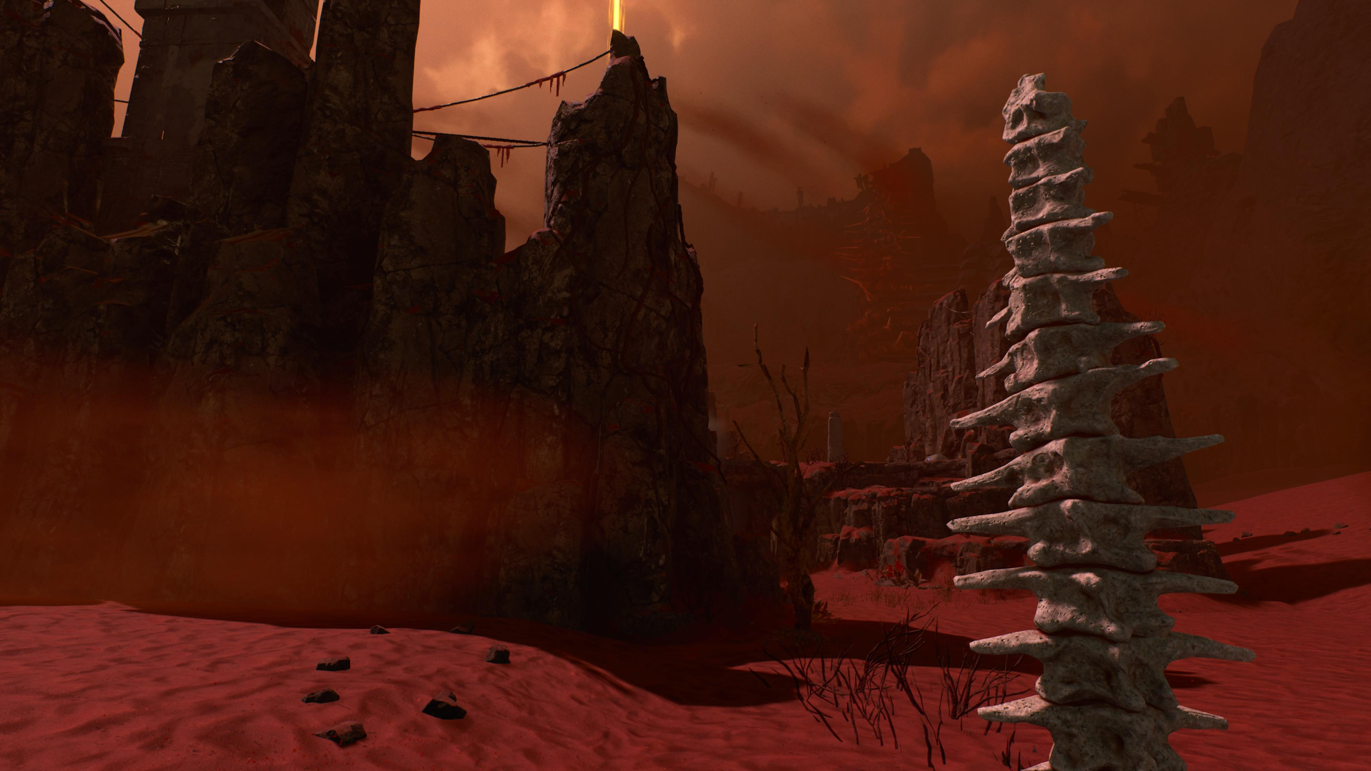

Fractured Mythology: Classical Reception and Player Mythopoesis in Housemarque’s Returnal
Scan the QR code or go to zbelliott.github.io/ReturnalMythopoesis for a copy of the paper’s text and PowerPoint.
Zachary Elliott
University of Pennsylvania

Slide 2
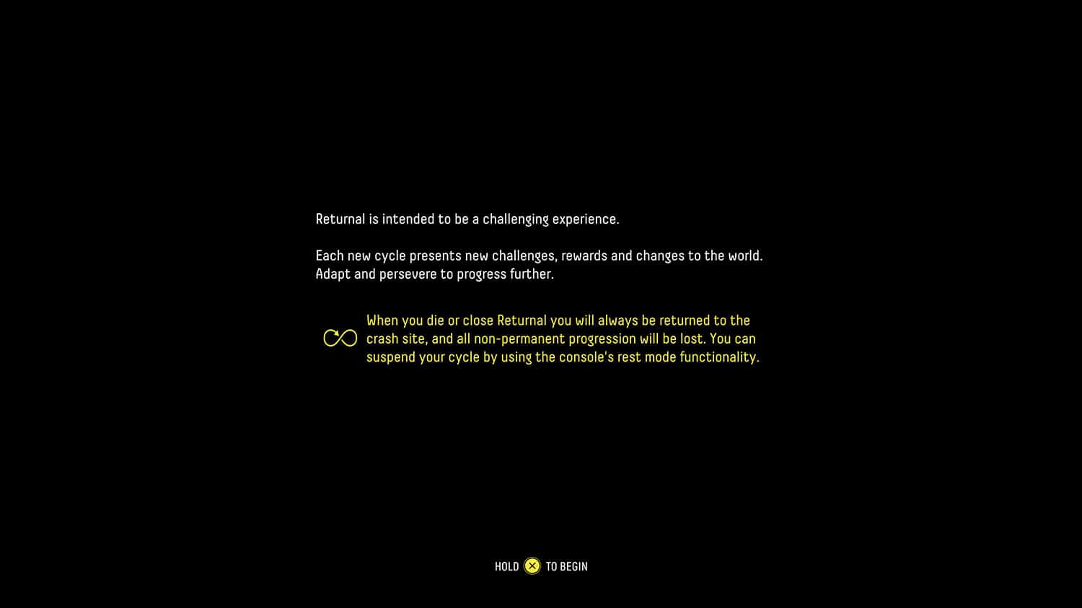

Slide 3
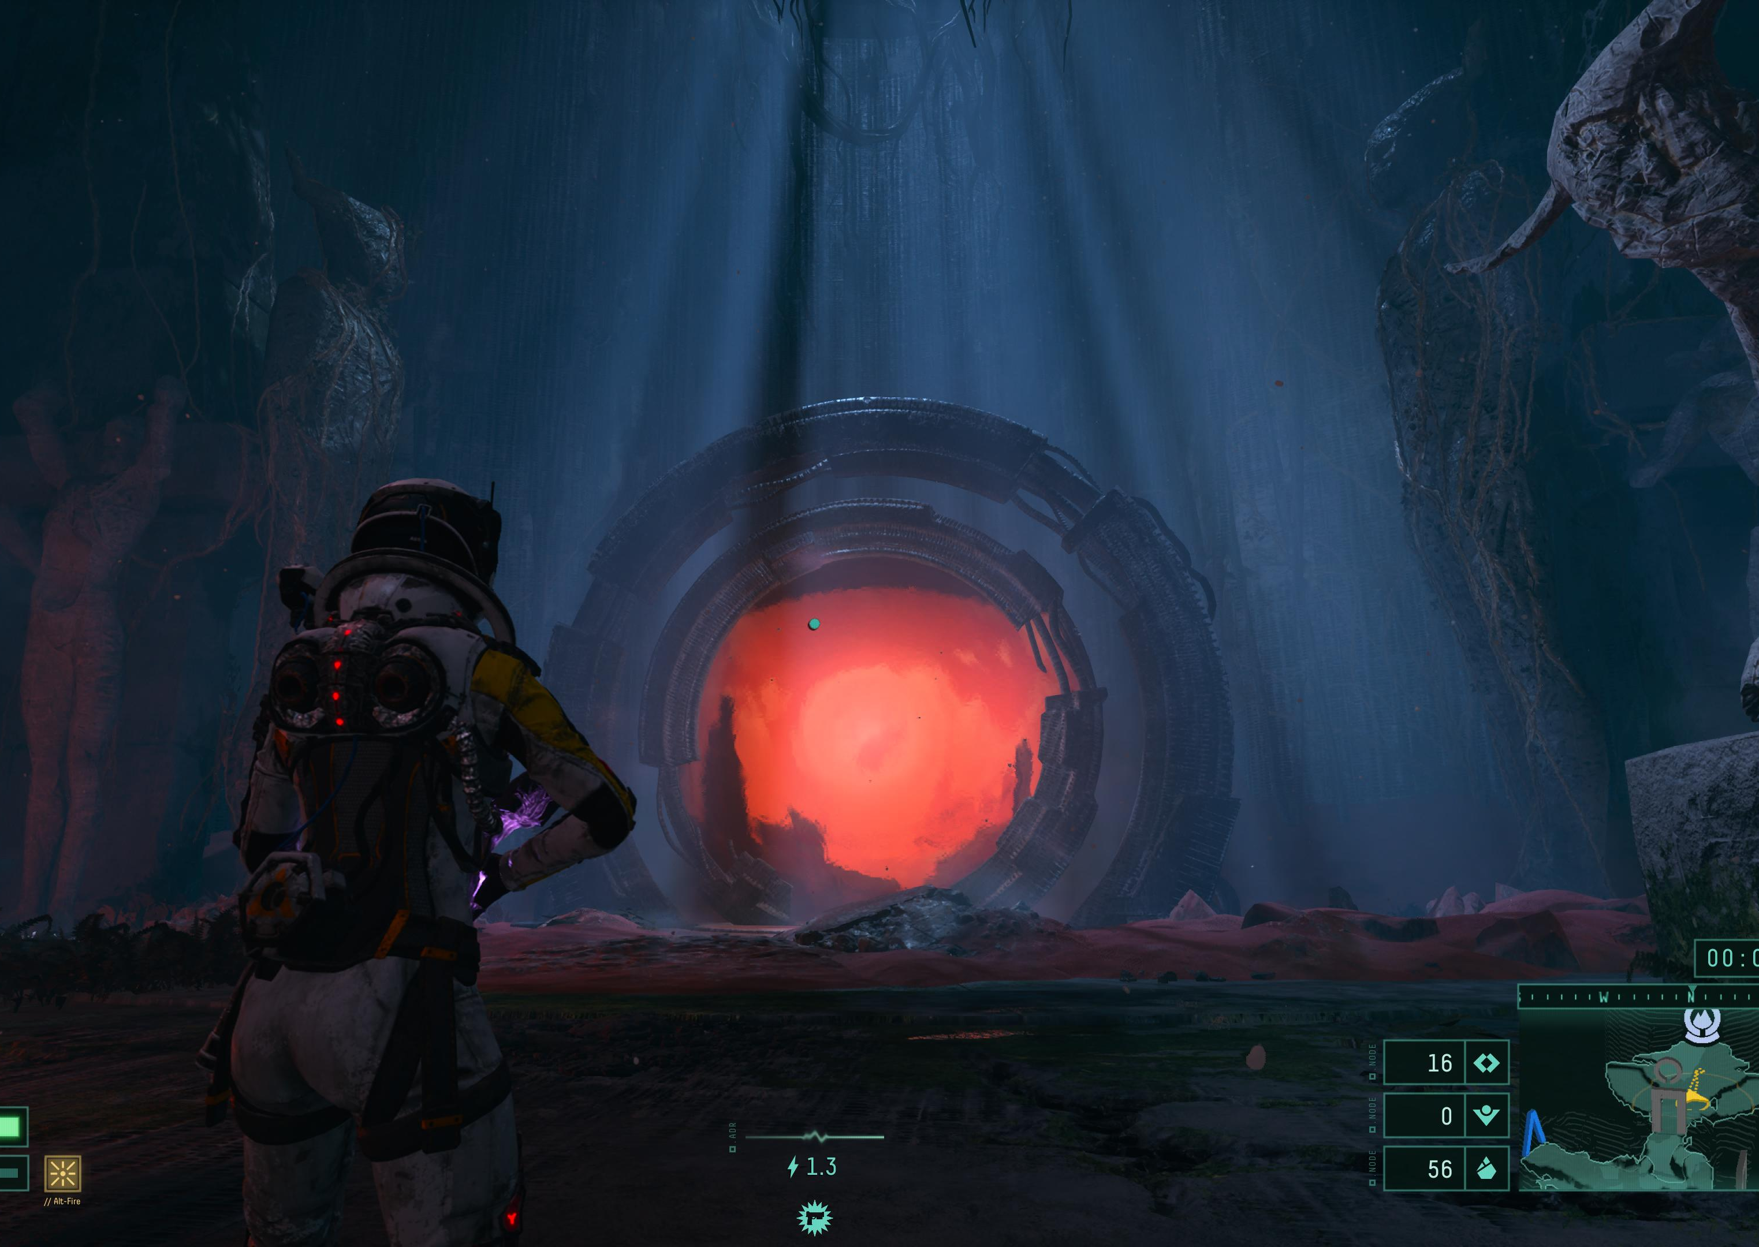
“A game’s use of received fiction cannot be understood separately from that game’s rules and mechanics.”
Mary McMenomy, “Reading the Fiction of Video Games” (2015).

Slide 4
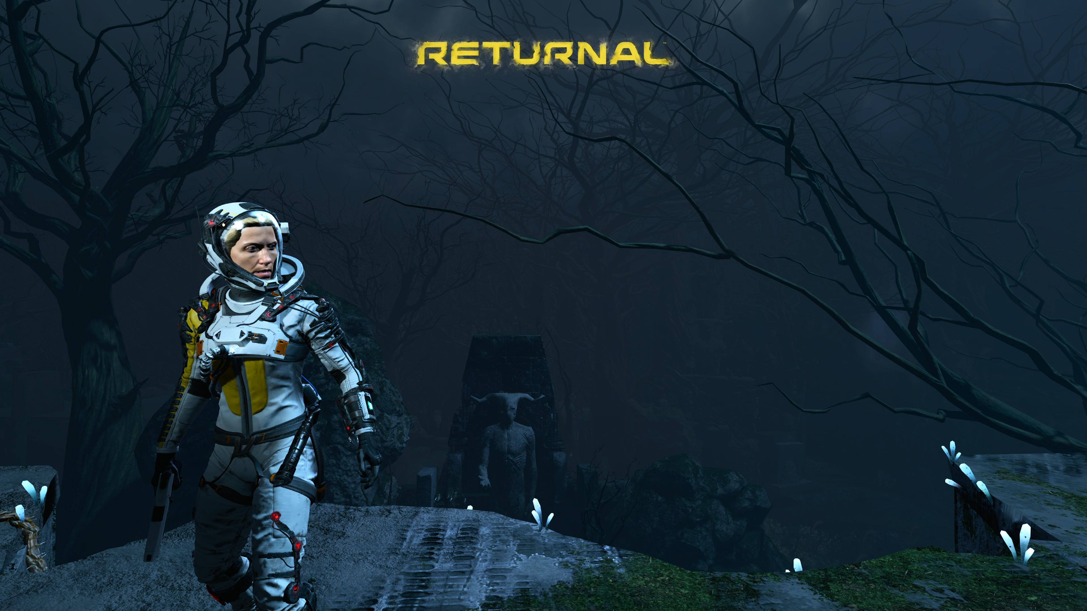

Slide 5
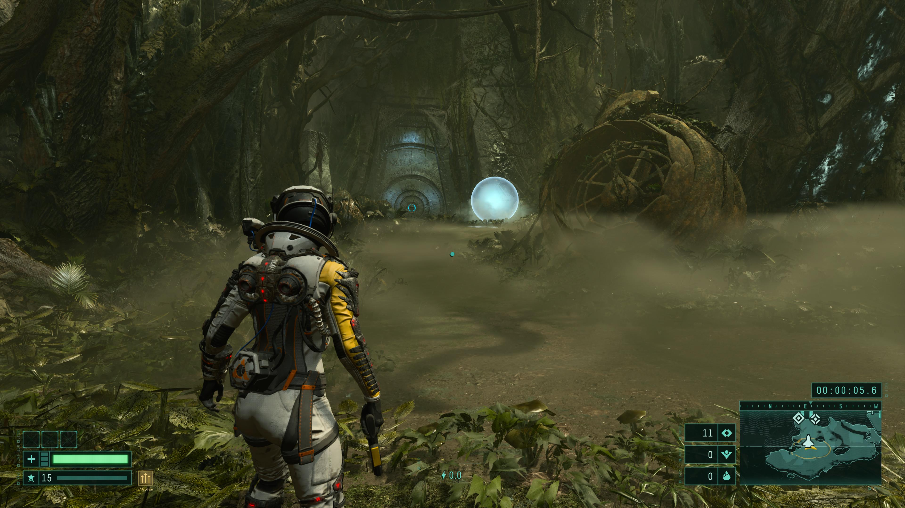

Slide 6
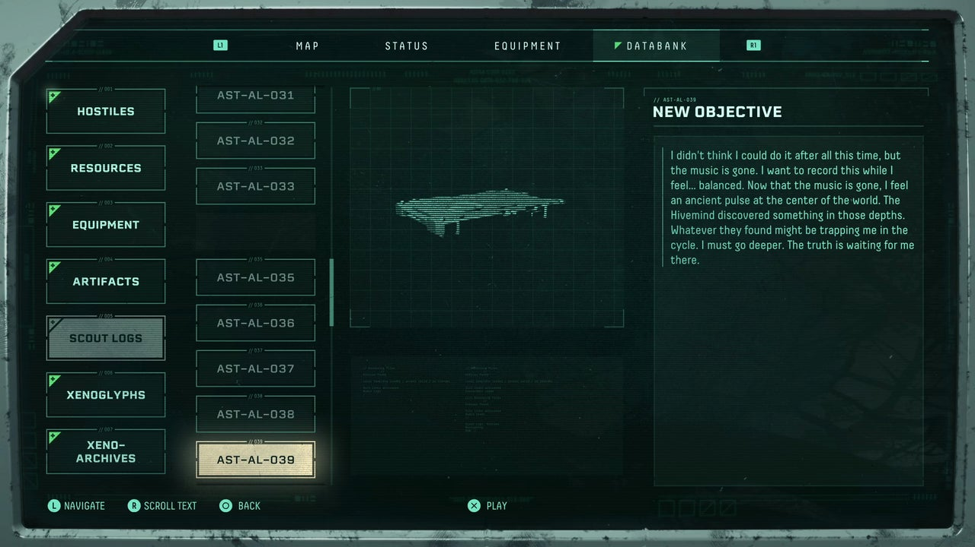

Slide 7
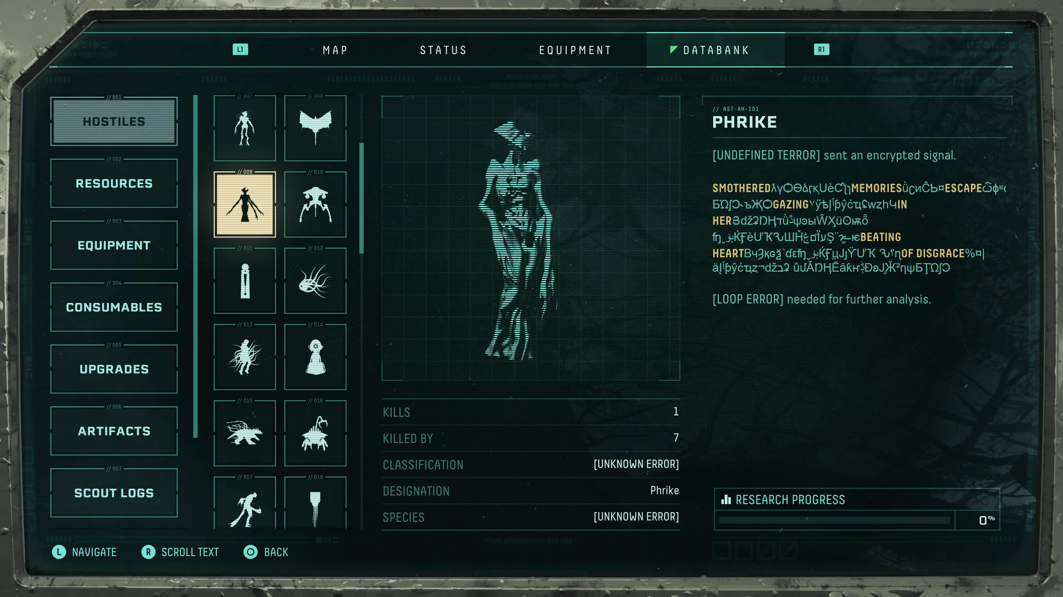

Slide 8
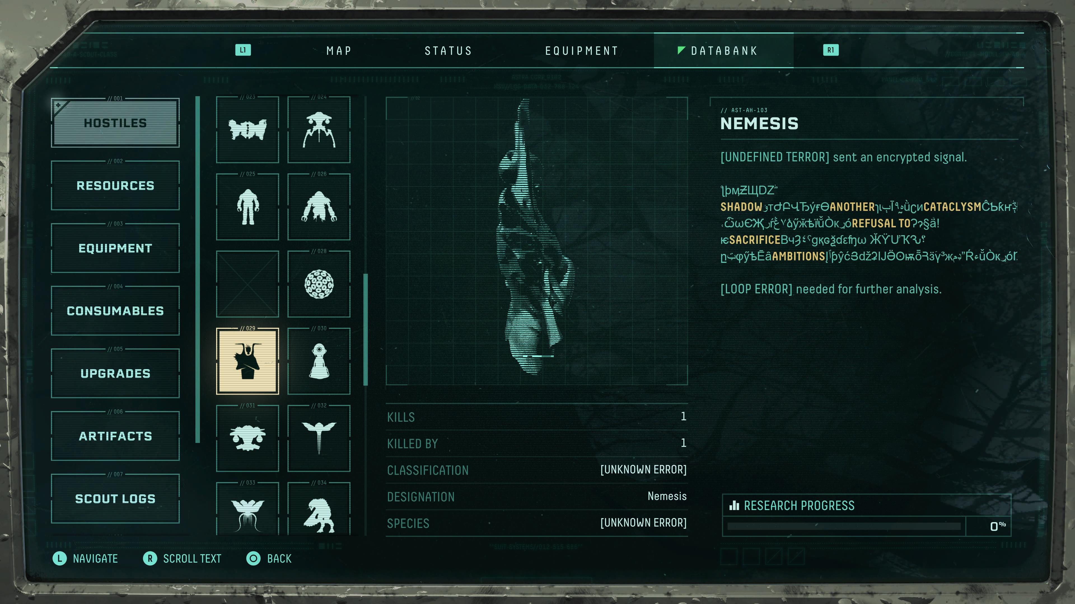

Slide 9
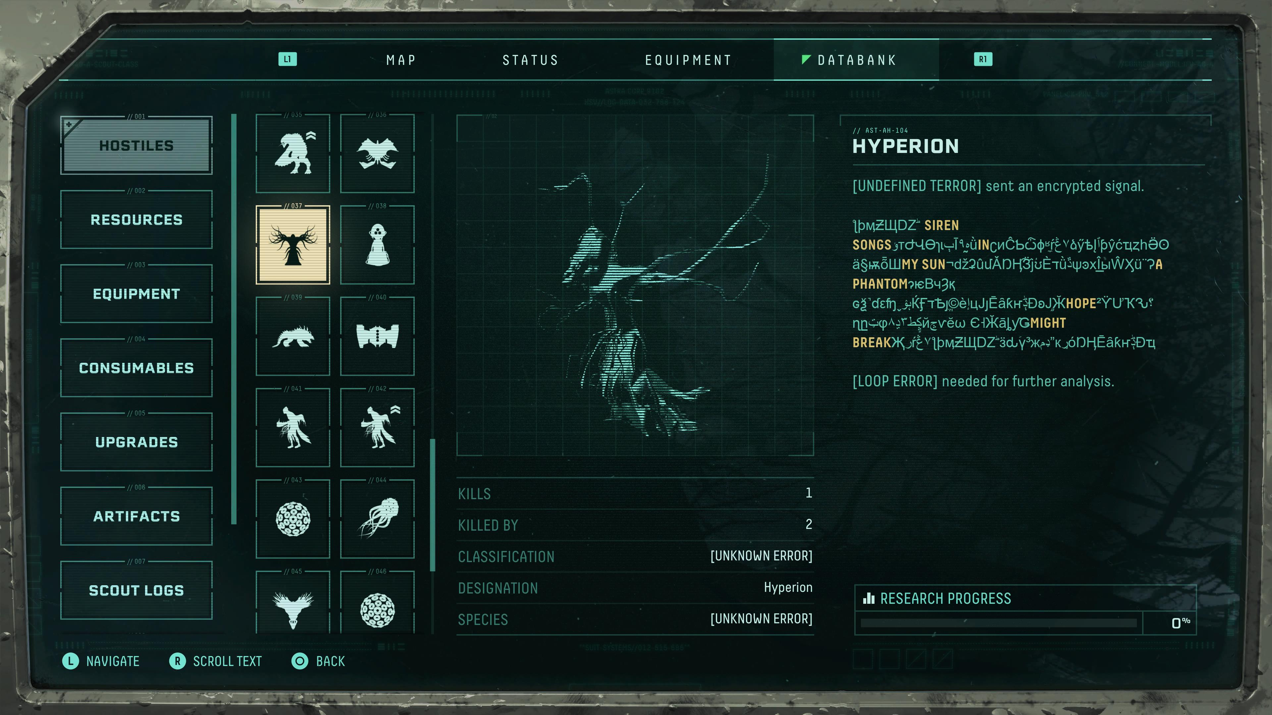

Slide 10


Slide 11
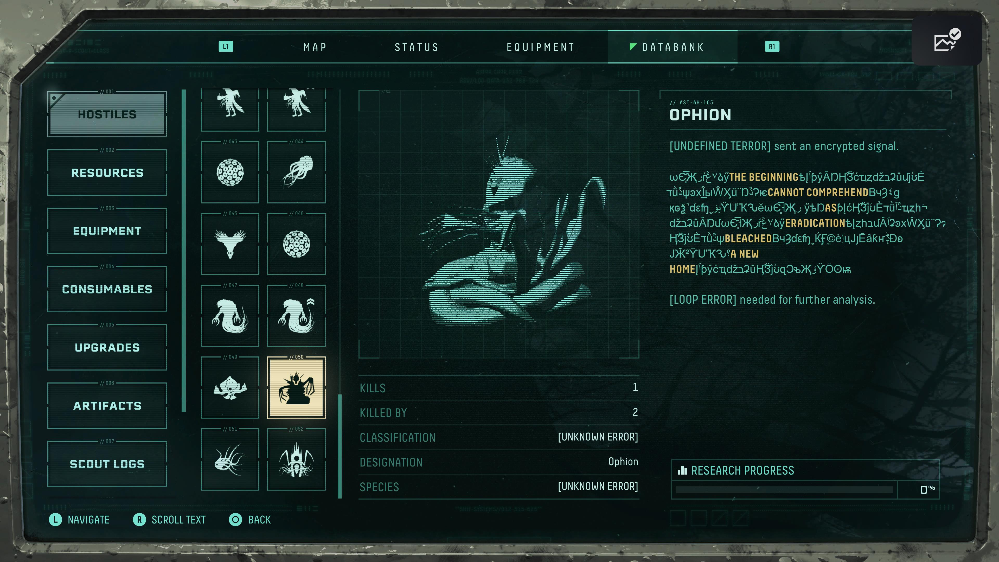

Slide 12
Signal partially decrypted. "Smothered fire. Suffocating memories. Promised
places.
Terminal escape. Gehenna. Helheim. Tartarus."

Slide 14
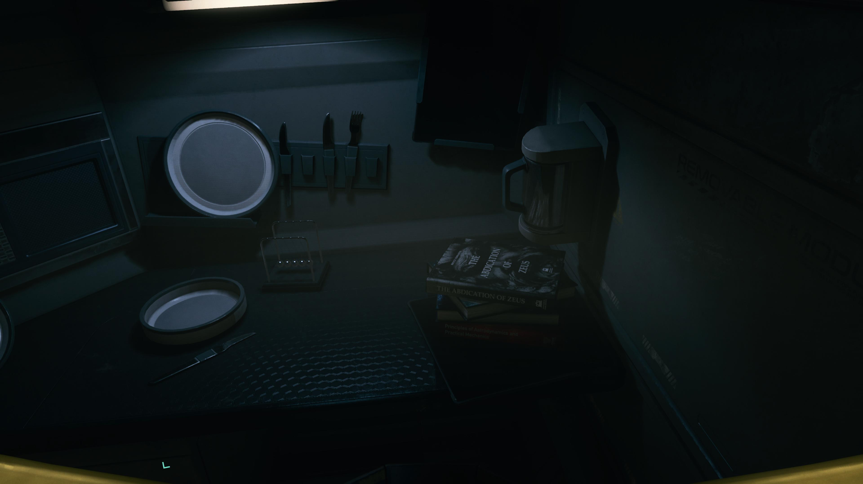

Slide 15


Slide 16
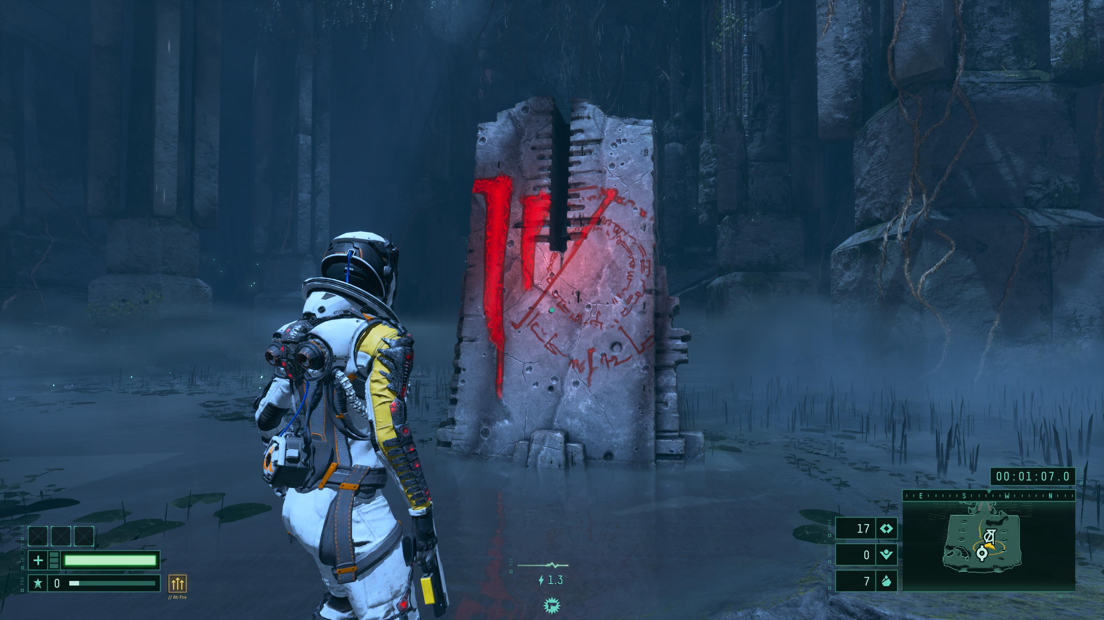

Slide 17
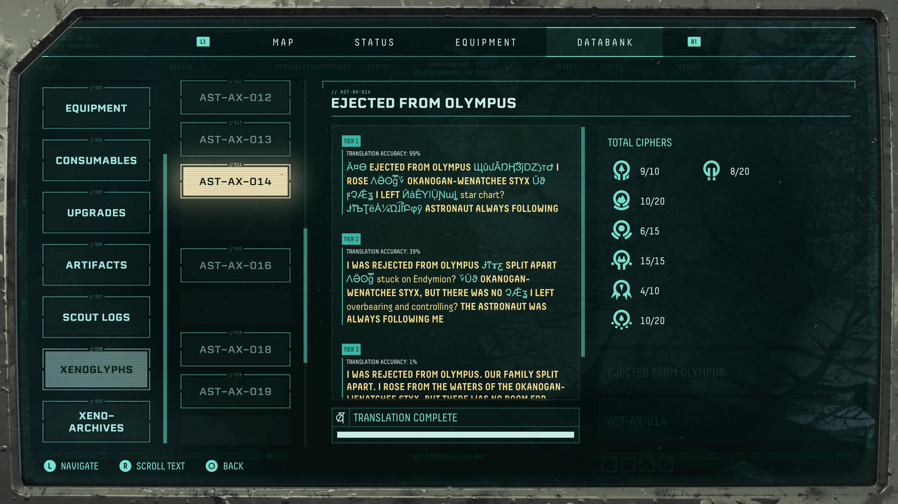
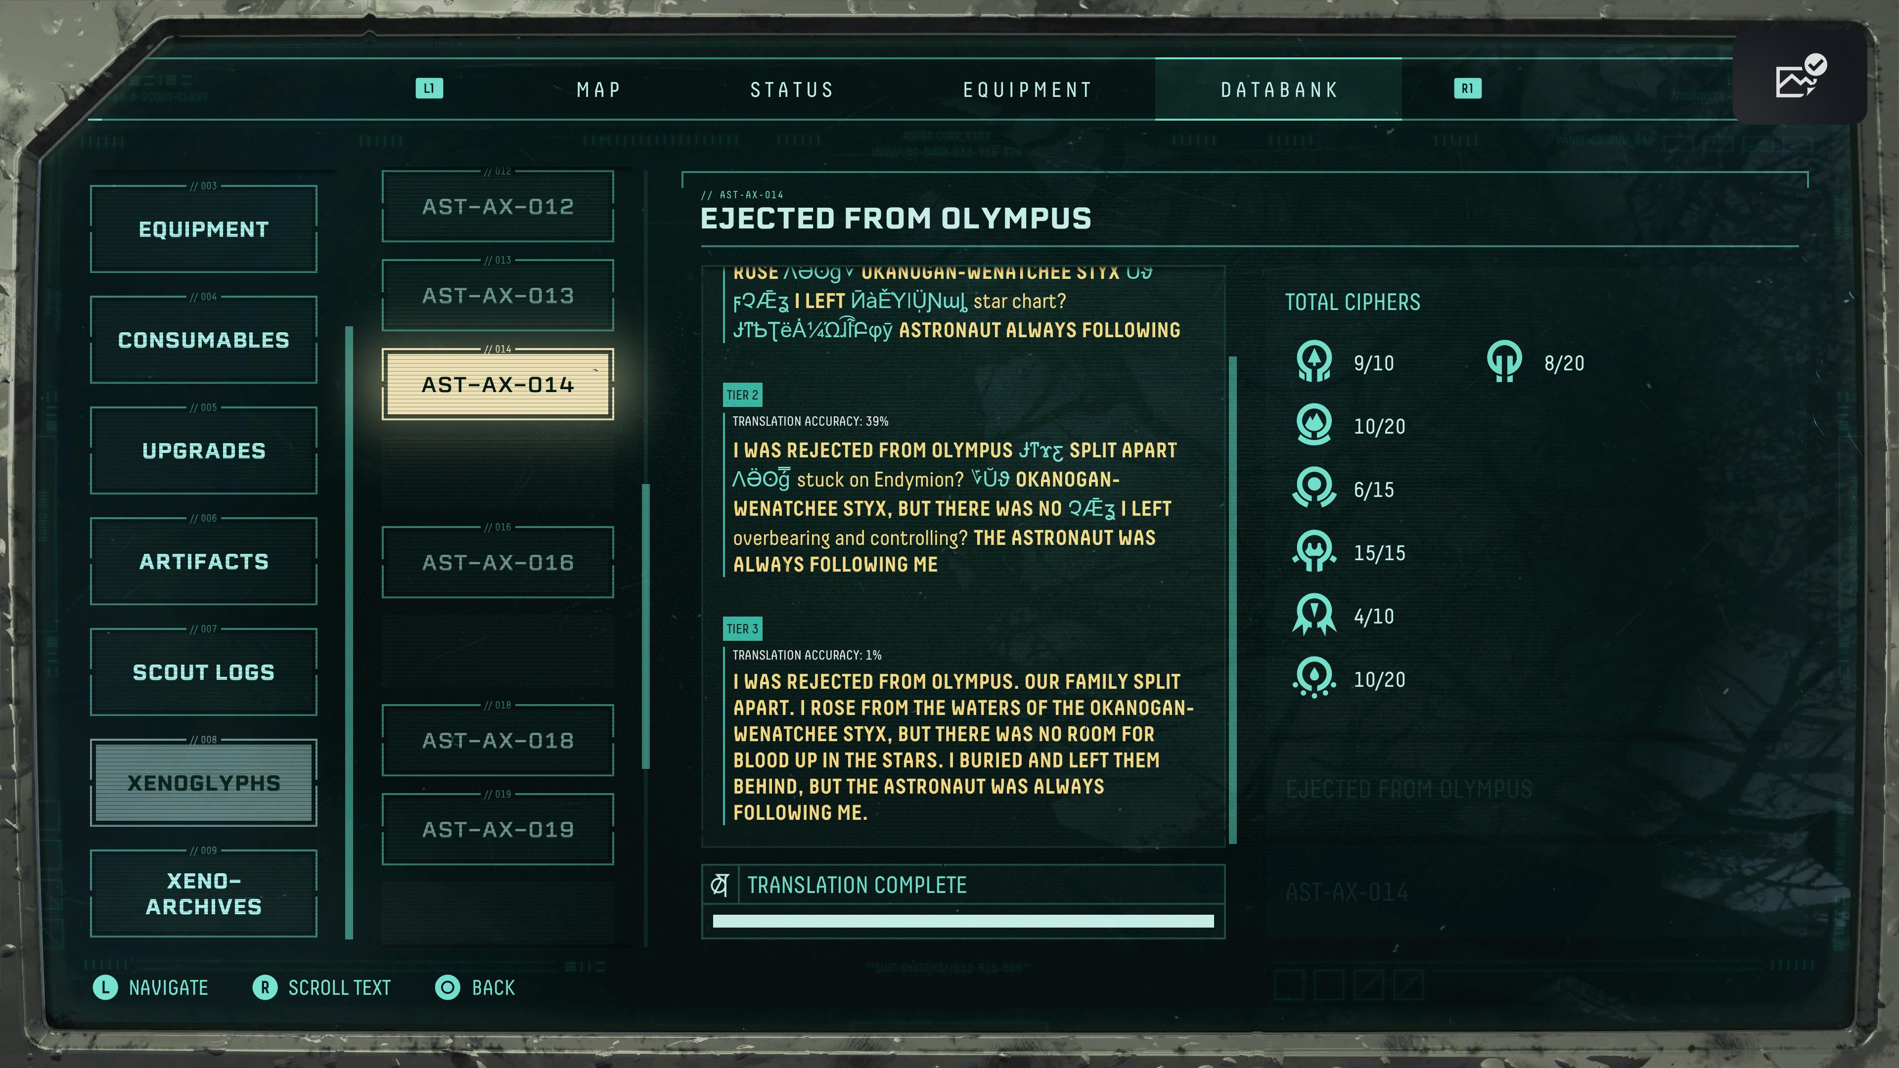

Slide 18
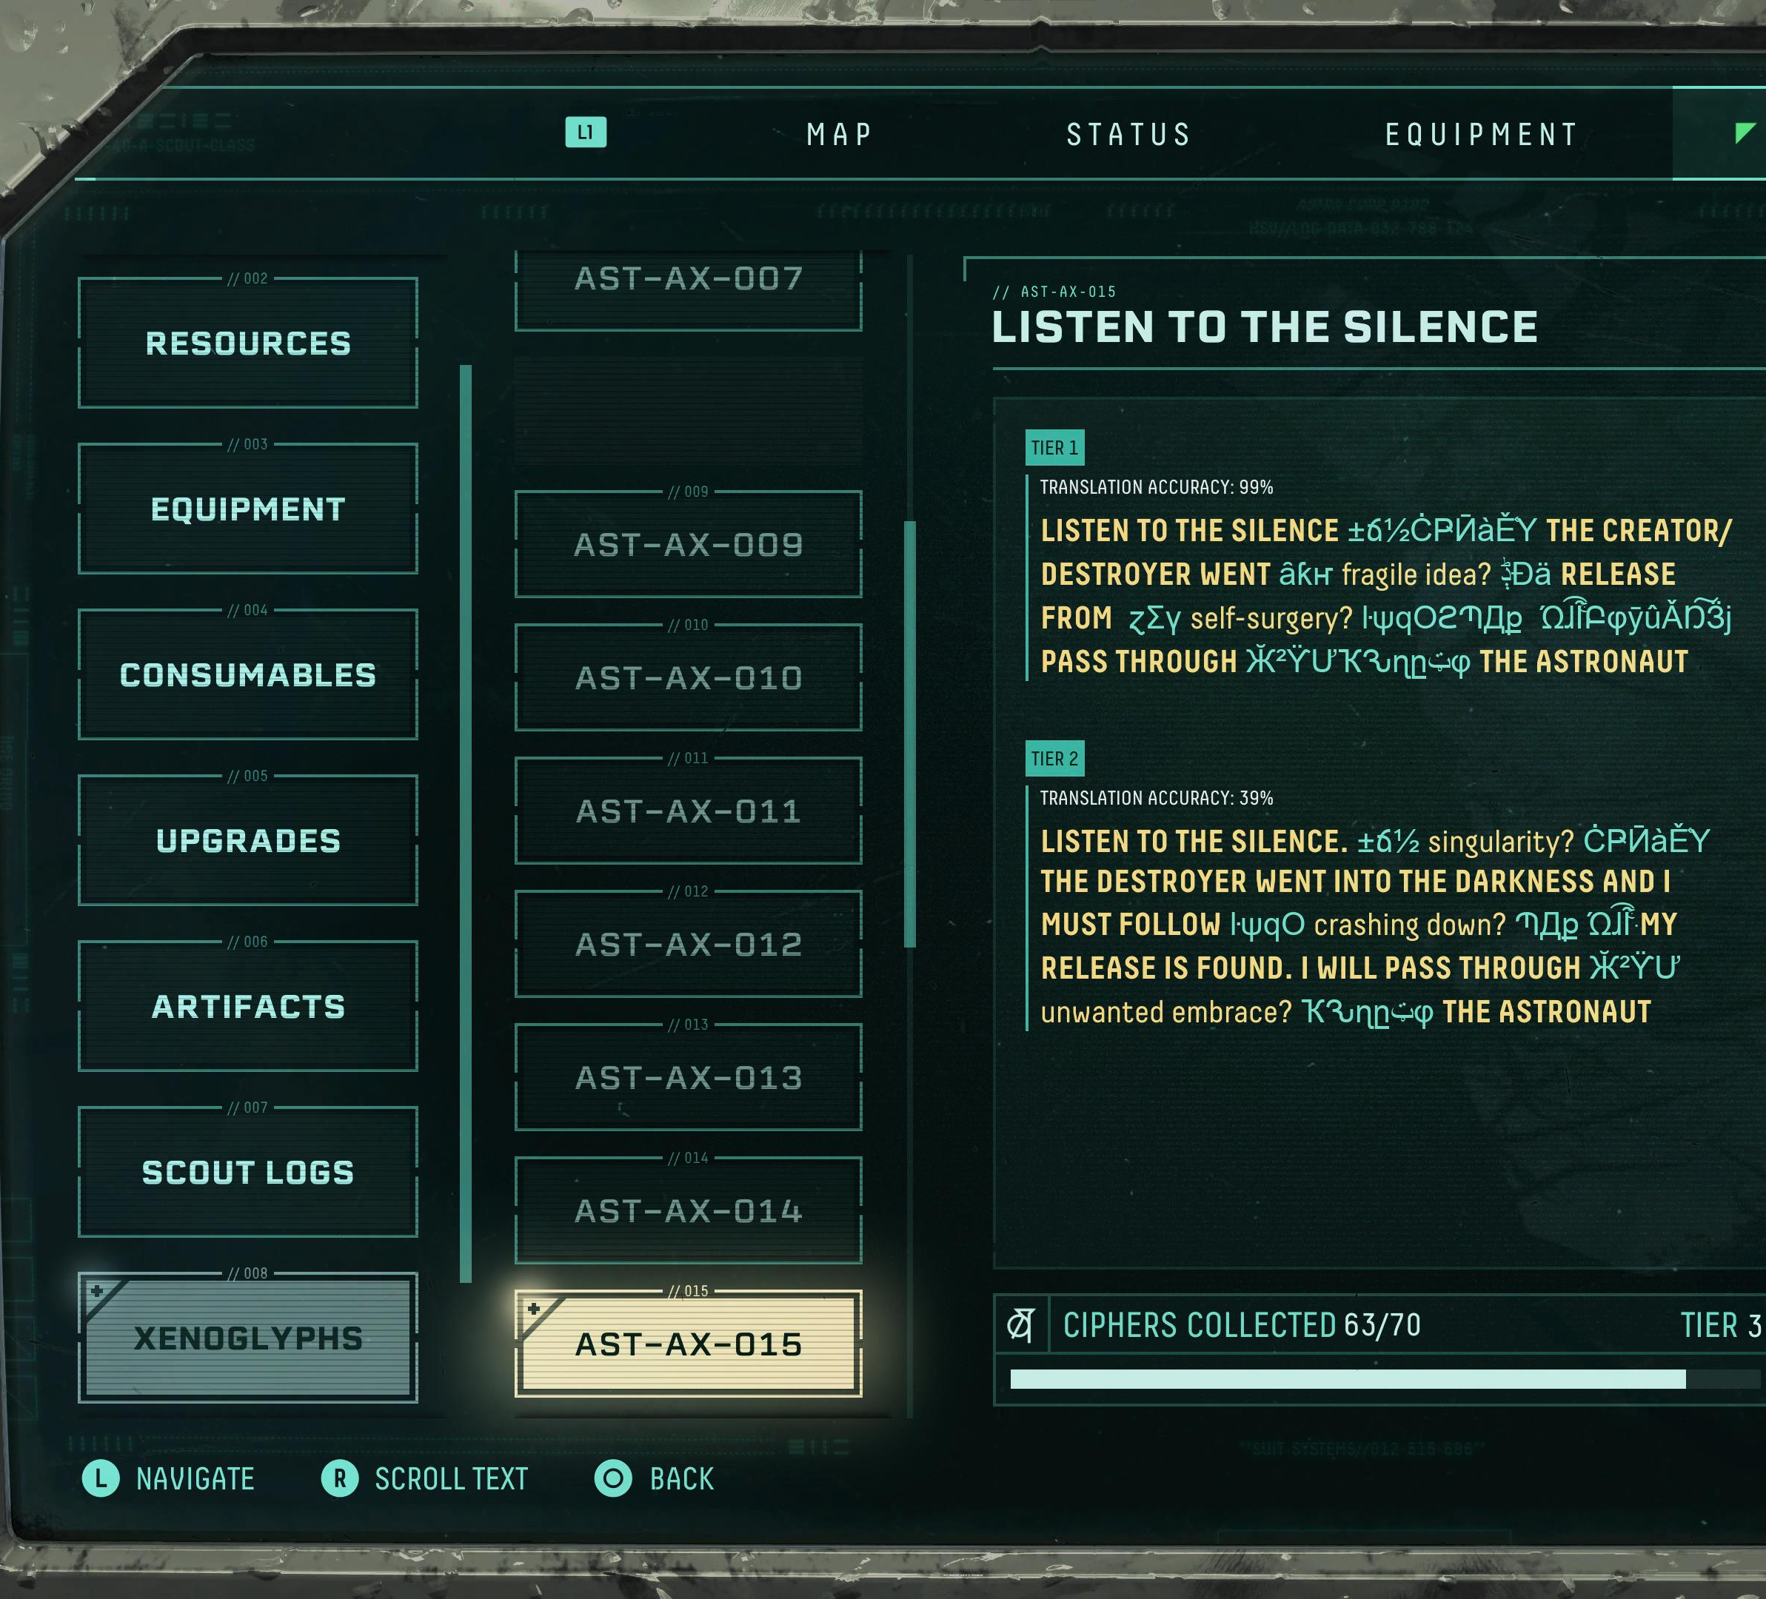
Tier 3
Translation Accuracy: 1%
LISTEN TO THE SILENCE, DEEPER THAN HADES AND BLACKER THAN TARTARUS: THE DESTROYER WENT INTO THE DARKNESS AND I MUST FOLLOW. THE UNIVERSAL GRAVE IS WHERE MY RELEASE IS FOUND. I WILL PASS THROUGH IT TO CONFRONT THE ASTRONAUT.

Slide 20
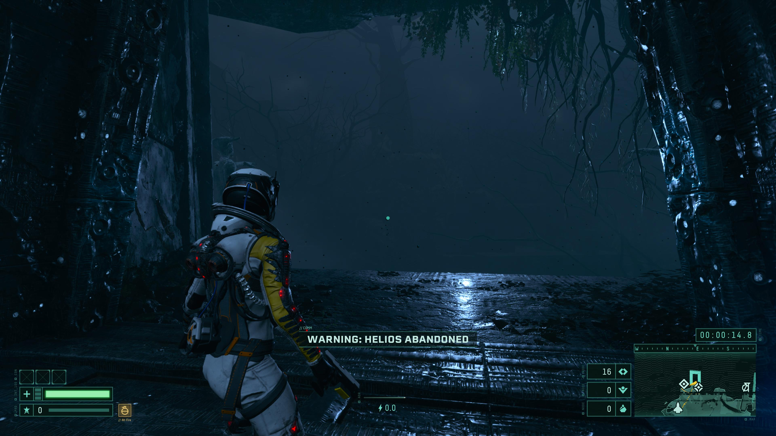

Slide 21
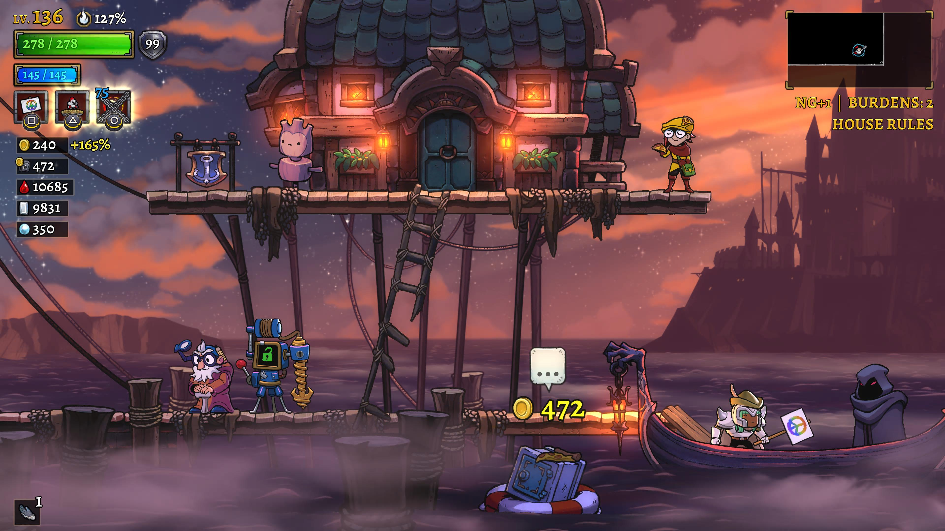
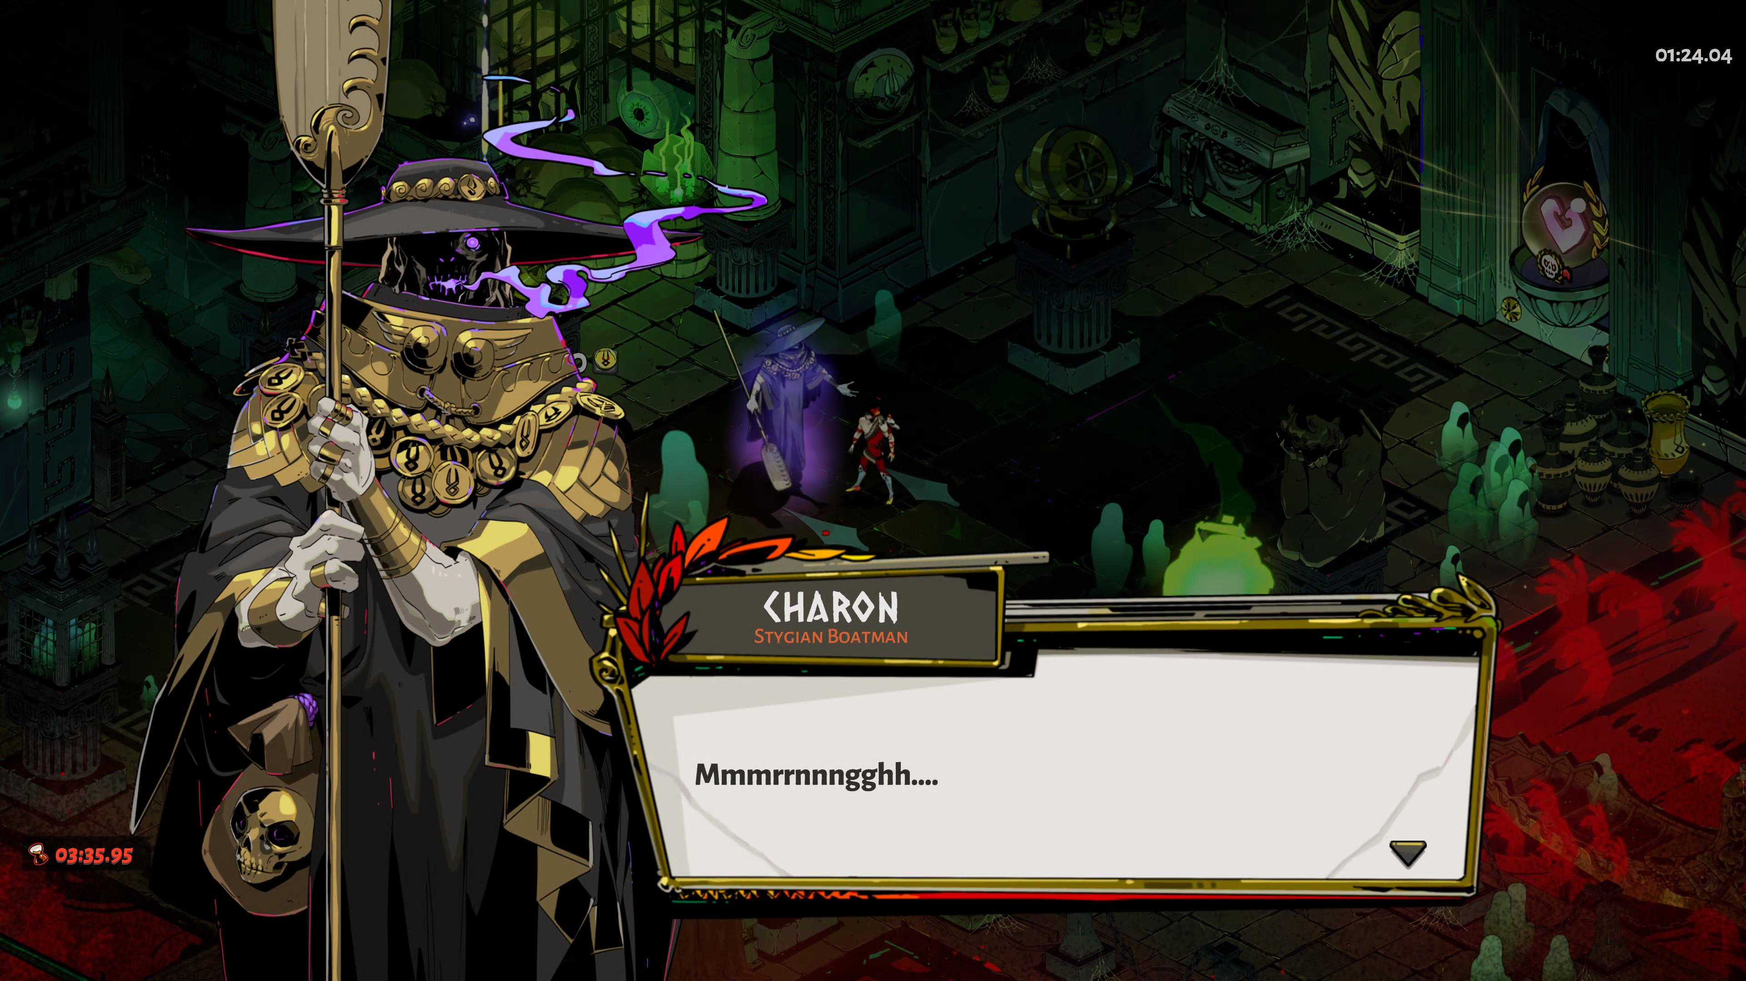

Charon, as he appears in Rogue Legacy 2 (left) and Hades (right)

Slide 22
Games and Works Cited
Games:
Hades, Supergiant Games, 2020
Returnal, Housemarque, 2021
Rogue Legacy 2, Cellar Door Games, 2022
Scholarship:
McMenomy, Mary. 2015. “Reading the Fiction of Video Games.” In The Reception of Ancient Greece and Rome in Children’s Literature: Heroes and Eagles, edited by Lisa Maurice. Brill.

